Slide 1
Distributed Energy Resources and Microgrids
ECpE Department
Dr. Zhaoyu Wang
1113 Coover Hall, Ames, IA
wzy@iastate.edu

Slide 2
Distributed Energy Resources and Microgrids
Acknowledgement:
The slides are developed based in part on Electric Power and Energy Distribution Systems, Models, Methods and Applications, Subrahmanyan S. Venkata, Anil Pahwa, IEEE Press & Wiley, 2022
ECpE Department

Slide 3
1. Introduction
Technological advances and decreasing prices are making deployment of distributed energy resources (DERs) attractive. In Chapter 4, we gave a brief introduction to DERs.
In this chapter, we provide detailed information on some of the popular DER technologies. In addition, we discuss the concept of microgrid (MG) and how deployment of DERs is facilitating formation and operation of MGs. Technologies associated with different DERs and their effective deployment in distribution systems are evolving.
While it is not possible to cover every aspect associated with DERs and MGs, in this chapter we present some of the most relevant topics.

Slide 4
2. DER Resources and Models
DERs based on wind and solar technologies, batteries, and microturbines are the most common resources at present. In this section, we present information related to them.

Slide 5
2.1. Wind Generation
Wind generation has limitations related to deployment in distribution systems. Firstly, wind generations lower than 1 MW are not very efficient, and thus, they are not viable for installation by homeowners or small businesses.
Larger businesses and distribution system operators (DSOs) may find them attractive under certain conditions. Secondly, if distribution systems are in the vicinity of homes and businesses, aesthetics becomes important.

Slide 6
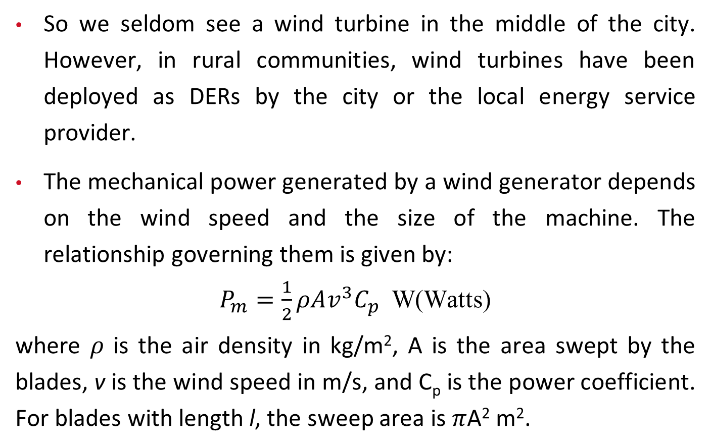
2.1. Wind Generation
So we seldom see a wind turbine in the middle of the city. However, in rural communities, wind turbines have been deployed as DERs by the city or the local energy service provider.
The mechanical power generated by a wind generator depends on the wind speed and the size of the machine. The relationship governing them is given by:
$P_{m}=\frac{1}{2}ρAv^{3}C_{p}$ W(Watts)
where 𝜌 is the air density in kg/m², A is the area swept by the blades, v is the wind speed in m/s, and C_{p} is the power coefficient. For blades with length l, the sweep area is 𝜋A² m².
(13.1)

Slide 7
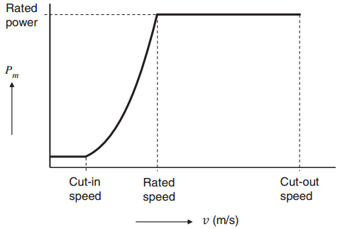
2.1. Wind Generation
The power captured by the wind turbine is a cubic function of wind speed as given by Eq. (13.1). However, this relationship is valid between the cut-in speed and the cut-out speed as shown in Figure 13.1.
Figure 13.1 Mechanical power output of wind turbines as a function of wind speed.

Slide 8
2.1. Wind Generation
The cut-in speed is the lowest speed at which the turbine creates enough motion to produce output power. The cut-out speed is the speed at which the turbine must be stopped to avoid damage due to high wind speeds.
Figure 13.1 Mechanical power output of wind turbines as a function of wind speed.

Slide 9
2.1. Wind Generation
The rated speed is in between the two speeds, and at this speed, the turbine produces the rated output. The cut-in speed is 6 to 9 miles per hour, the rated speed is about 30 miles per hour, and the cut-out speed is about 55 miles per hour of steady wind.
Figure 13.1 Mechanical power output of wind turbines as a function of wind speed.

Slide 10
2.1. Wind Generation
The wind turbine is connected to a gear box, which is connected to the generator that produces electrical power. The initial designs of wind generators were based on squirrel cage induction generator, and they operated at fixed speed. Doubly fed induction generators (DFIGs) are the most used for wind generators presently.
These generators operate in a range of speeds around the synchronous speed. Synchronous generators can also be used for generating electrical power. The details are beyond the scope of this book, but the readers are suggested to other look at published books on the subject .

Slide 11
2.2. Solar Generation
Solar photovoltaic (PV) and concentrated solar power (CSP) are the two common approaches used for producing electricity. CSP requires a large infrastructure, and it is only suitable for large-scale deployment in bulk power systems. In contrast, solar PV has a range from 200 W to hundreds of MW.
Therefore, it can be installed on rooftops of homes and businesses and as a stand-alone on-ground facility within a city.

Slide 12
2.2. Solar Generation
Solar PV is also attractive from aesthetics because it blends in with the roof lines of structures, and on-ground installations look attractive if properly done. According to Solar Energy Industry Association (SEIA), the total energy generated from solar plants in the United States was 104 billion kWh in 2019, of which approximately 33% was from rooftop distributed PV systems with less than 1 MW generation capacity.
Various countries, and states and utilities within the U.S. have used policies and incentives to promote distributed solar energy, which has resulted in different levels of deployment of solar energy around the world.

Slide 13
2.2. Solar Generation
Deploying solar PV as DER has many challenges, which span technical, economic, social, and policy domains. On the technical side, sizing, siting and aggregate capacity of the PV systems, impacts on the local system as well as adjoining utility grid, and coordination with the existing generation are some of the issues.
Economic issues include cost of installation and maintenance of the PV system; individually owned versus community-owned systems; economic impact of various energy pricing models on citizens, the service provider, and the utility.

Slide 14
2.2. Solar Generation
Social aspects for consideration include attitudes of the stakeholders in the community toward solar energy and social equity for the citizens. Local governments can implement policies to increase deployment of solar PV in their communities while ensuring that economic and social equity is maintained.

Slide 15
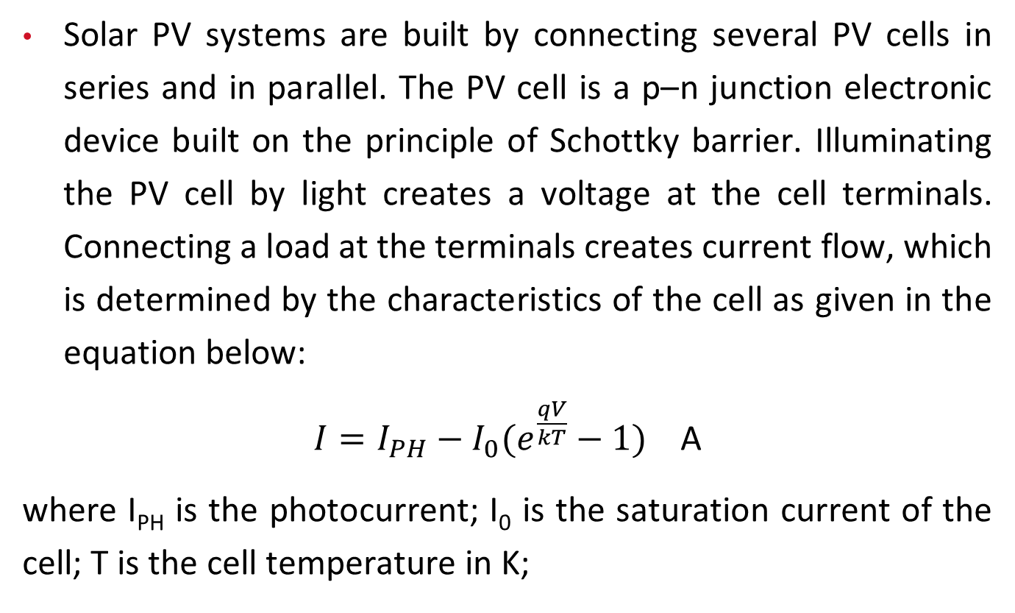
2.2. Solar Generation
Solar PV systems are built by connecting several PV cells in series and in parallel. The PV cell is a p–n junction electronic device built on the principle of Schottky barrier. Illuminating the PV cell by light creates a voltage at the cell terminals. Connecting a load at the terminals creates current flow, which is determined by the characteristics of the cell as given in the equation below:
$I=I_{PH}−I_{0}(e^{\frac{qV}{kT}}−1)$ A
where I_{PH} is the photocurrent; I₀ is the saturation current of the cell; T is the cell temperature in K;
(13.2)

Slide 16
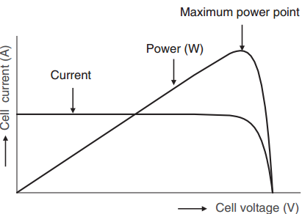
2.2. Solar Generation
q is the charge of an electron, which is 1.6 × 10−19 C; and k is a constant equal to 1.38 × 10−23 Joules/∘K. Normally, I_{PH} ≫ I₀ with the ratio of photocurrent to saturation current in the 10¹⁰ range. Although the actual characteristics are slightly different, Eq. (13.2) provides an ideal version of the PV cells. A graph based on it is shown in Figure 13.2.
Figure 13.2 Solar PV cell characteristics.

Slide 17
2.2. Solar Generation
Multiplying V by I gives the power output of the cell, as shown in Figure 13.2. Note that there is a maximum power point on this graph. Typically, solar PV systems are operated close to this point by maximum power point tracking (MPPT).
While the maximum cell voltages remain the same, the current and the power output increase with higher illumination because the photocurrent increases.

Slide 18
2.2. Solar Generation
Also, note that the cell characteristics change with temperature. Although the short-circuit current remains almost constant, the open-circuit voltage increases with lower cell temperature. Consequently, the cell power increases with decrease in cell temperature. Typically, the cell power decreases by 0.5% per ∘C increase in temperature. That is why the solar plants produce lower output during the peak summer season.

Slide 19
2.3 Battery Energy Storage System (BESS)
Batteries are used by people in many everyday applications, such as smart phones, computers, and cars. Their use for energy storage in power systems has been limited due to cost.
Now, with declining cost, increased performance, and longer life, their deployment is gradually increasing. Large-scale battery storage is being deployed at the bulk power system level to support variable output of wind and solar resources and as a source of energy to enhance resiliency in the event of grid failure.

Slide 20
2.3 Battery Energy Storage System (BESS)
However, deployment at the distribution level has been limited. With further decline in price, batteries are being deployed in distribution systems. Nonetheless, an indirect form of battery storage is appearing in distribution systems in the form of electric vehicles (EVs).
Although the subject of vehicle-to-grid (V2G) interaction has been discussed for many years, individual owners will not find participation in two-way V2G interaction attractive due to degradation of batteries as well as warranty concerns. But V2G interaction is quite feasible for fleet operators in exchange for attractive rates provided by the utilities.

Slide 21
2.3 Battery Energy Storage System (BESS)
In the future, with further decline in prices, we can expect to see increased deployment of BESS in distribution systems as well as in homes. However, it is important to understand that any energy that is stored in batteries and used later will have a higher cost per kWh. Therefore, there must be a compelling need to store energy for use at a later period.
A specific example includes storing energy when the price of electricity is low and using it when the price is high.

Slide 22
2.3 Battery Energy Storage System (BESS)
In distribution systems with high penetration of solar PV, batteries can store energy during peak hours to prevent excessive reserve flow from the distribution system into the transmission system. The stored energy can be used during sundown to prevent excessive ramping of other generators to meet the load.
In addition, the use of BESS in conjunction with solar PV plant can mitigate adverse effects of rapid fluctuations in power and voltage due to intermittent clouds. BESS also provides a good value for locations with high frequency of electricity supply interruptions and for sensitive loads that require continuous power supply.

Slide 23
2.3 Battery Energy Storage System (BESS)
Lead-acid batteries were the most used batteries in the past for BESS due to their maturity. However, lately, several chemistries for batteries have been tested. Lithium-ion is the most used battery chemistry at present.
However, there are significant concerns about the long-term availability of rare earth elements needed to build them and environmental issues related to mining the needed elements and disposal of used batteries.

Slide 24
2.3 Battery Energy Storage System (BESS)
Lead-acid batteries were the most used batteries in the past The quest for more environment friendly and cheaper batteries is ongoing.
In addition, recent advances in redox-flow batteries are promising. Redox-flow stores energy in the electrolyte, which is pumped through the cell to charge or discharge.

Slide 25
2.3 Battery Energy Storage System (BESS)
Modeling of batteries to determine the state of charge (SOC) and the state of health (SOH) for integrating them optimally into power systems is a very complex process because internal measurements are not available. Typically, only the terminal voltage, current flow, and temperature are available. A simple and effective method to model batteries is based on empirical approaches.
In this approach, a mathematical function is used to fit the past performance, which is then used to predict the future.

Slide 26
2.3 Battery Energy Storage System (BESS)
These models lack physical meaning, and they are not accurate outside of the conditions in which they were built. Equivalent circuits-based approach is another way to model batteries. They also do not effectively account for physical basis and lack accuracy for efficient operation of batteries.

Slide 27
2.3 Battery Energy Storage System (BESS)
To achieve higher accuracy, we must use physics-based models. These models use mathematical representation of the chemical and thermal phenomena inside the battery and combine them with externally available measurements of voltage, current, and temperature to represent the overall dynamics of the batteries. We will not discuss the details of such models in this chapter.

Slide 28
2.3 Battery Energy Storage System (BESS)
Since batteries produce dc voltage, they must be connected to inverters to produce ac voltage for interconnection to the power grid. The ac side will also have a transformer to step up the voltage if the output ac voltage of inverter is lower than the power grid voltage.

Slide 29
2.4 Microturbine
Microturbines are gas turbines with a radial compressor and turbine rotors. They rotate at very high speed, such as 96 000 rpm, and their capacity ranges from 30 to 250 kW. They typically use a heat recovery system to recover exhaust heat to preheat compressed inlet air, which increases efficiency.

Slide 30
2.4 Microturbine
They produce ac voltage at a very high frequency, which is converted to ac at 60 Hz using a series of converters, which convert ac to dc and then dc to ac. Due to their size, they are usually suitable for industrial or commercial facilities, where high reliability of power supply is required. They are also used as a standby source of power in MGs.

Slide 31
2.5 Electric Vehicles
Although the first electric car was introduced over 100 years ago, only now they are entering the mainstream due to declining cost and performance of batteries. Several manufacturers are offering attractive models for customers to choose from. While they are still more expensive than the traditional automobiles, their cost is expected to decrease in the future.
Several major automobile manufacturers have announced their plans to completely phase out the production of fossil fuel vehicles or to reduce their share in the portfolio within the next 10–20 years.

Slide 32
2.5 Electric Vehicles
Increased ownership of EVs will pose new planning and operating challenges for the utilities. They will increase the overall energy consumed as well as the power demand on the system. The increased power demand will have consequences from the distribution transformer feeding a few customers to adequacy of feeder sizes as well as other equipment in the system. If all the customers being fed power from a distribution transformer migrate to EVs, they will likely create a new peak in the night if all of them charge their vehicles simultaneously. The new peak could be higher than the capacity of the transformer in many cases.

Slide 33
2.5 Electric Vehicles
Since Level 1 chargers take several (10–12) hours to recharge the batteries, time-staggered charging is not a viable option. Time-staggered charging is possible with Level 2 chargers, which take 3–5 hours to recharge the batteries.
However, Level 2 chargers are an additional expense, and how many customers will opt for it is not fully clear at present. Similarly, the feeders and the substation transformer could get overloaded if large number of EVs charge their vehicles simultaneously. While the present level of EVs has not created any issues for the DSOs, major issues can arise in the future for which the DSOs have to be prepared.

Slide 34
2.5 Electric Vehicles
Although in most cases, EVs receive power from the grid, they can also inject power into the grid. The idea of V2G power transfer has been discussed for many years now, but it has not been implemented at a wide scale. There is no incentive for an individual EV owner to engage in V2G power transfer. The operator of a fleet of EVs could possibly engage in V2G activities if there is adequate financial incentive offered by the DSO. As far as modeling of EVs for distribution system analysis is concerned, the models of BESS will apply to EVs too because parked EVs are nothing but batteries.

Slide 35
3. Interconnection Issues
Interconnecting DERs in distribution systems could cause reverse power flows, power and voltage fluctuations, voltage rise, and protection issues. These issues become more pronounced with increasing deployment of DERs in the system. Since customer-owned rooftop solar PVs are behind the meter with no direct control, they create maximum concern for the system operator. Rapid fluctuations of power due to intermittent clouds cause voltage fluctuations, which is also a concern.

Slide 36
3. Interconnection Issues
Under the ideal situation, every customer in the system would have a rooftop solar PV, but practical issues limit such a scenario. Presently, 15–20% of load served by distributed rooftop solar PV is regarded as the hosting capacity limit by several utilities. However, with implementation of smart inverters and batteries, the hosting capacity can be increased in the future. IEEE Standard 1547-2018 discusses interconnection issues for inverter-based resources (IBRs) in general.

Slide 37
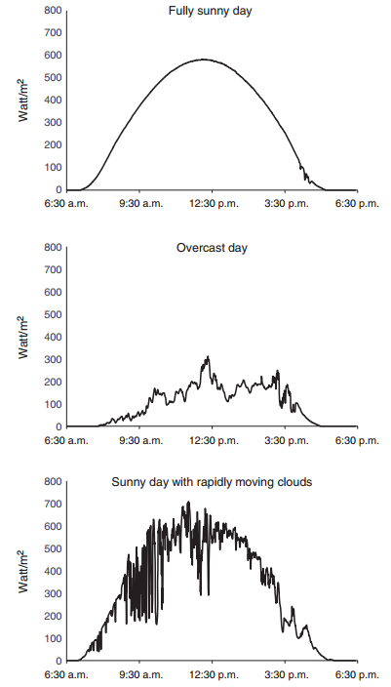
4. Variable Solar Power
Figure 13.3 shows examples of solar irradiation in Manhattan, Kansas, on three different days.
The first example shows a day with full sunshine, which would result in steady electricity generation in proportion to the irradiation.
The second example shows an overcast day with low solar irradiation and electricity generation.
Figure 13.3 Examples of solar irradiation recorded with 30-second resolution in Manhattan, Kansas. Source: Courtesy of Kansas State University

Slide 38
4. Variable Solar Power
The third example shows a day with rapidly moving clouds on a sunny day causing fluctuating output from the solar panels, which result in fluctuations in power flow and voltage at several points in the system.
Figure 13.3 Examples of solar irradiation recorded with 30-second resolution in Manhattan, Kansas. Source: Courtesy of Kansas State University

Slide 39
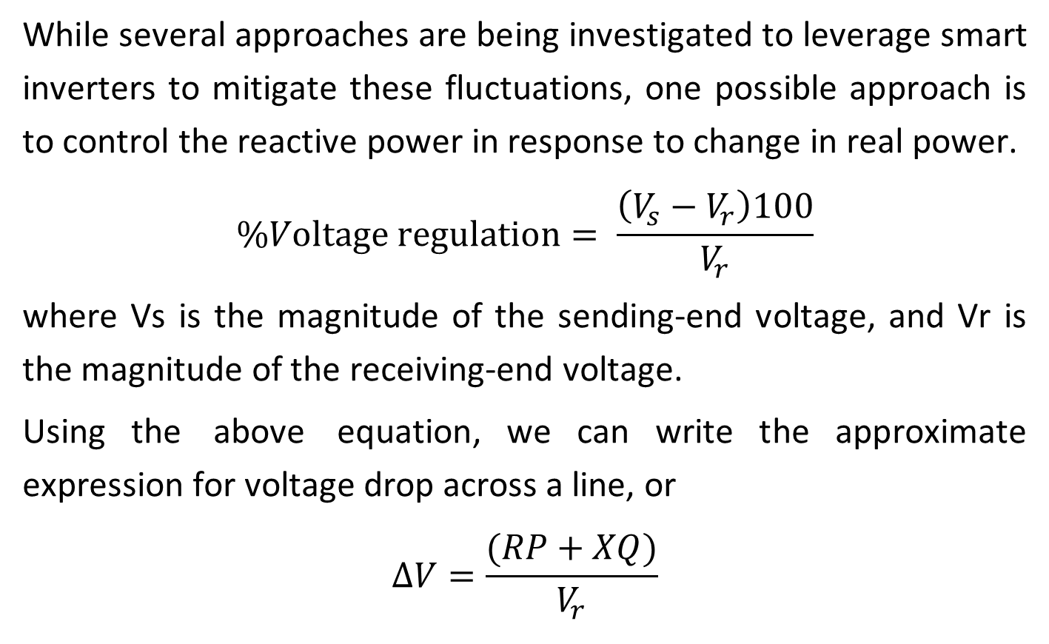
4. Variable Solar Power
While several approaches are being investigated to leverage smart inverters to mitigate these fluctuations, one possible approach is to control the reactive power in response to change in real power.
$$\%Voltage regulation= \frac{\left(V_{s}−V_{r}\right)100}{V_{r}}$$
where Vs is the magnitude of the sending-end voltage, and Vr is the magnitude of the receiving-end voltage.
Using the above equation, we can write the approximate expression for voltage drop across a line, or
$$∆V=\frac{(RP+XQ)}{V_{r}}$$
(13.3)

Slide 40
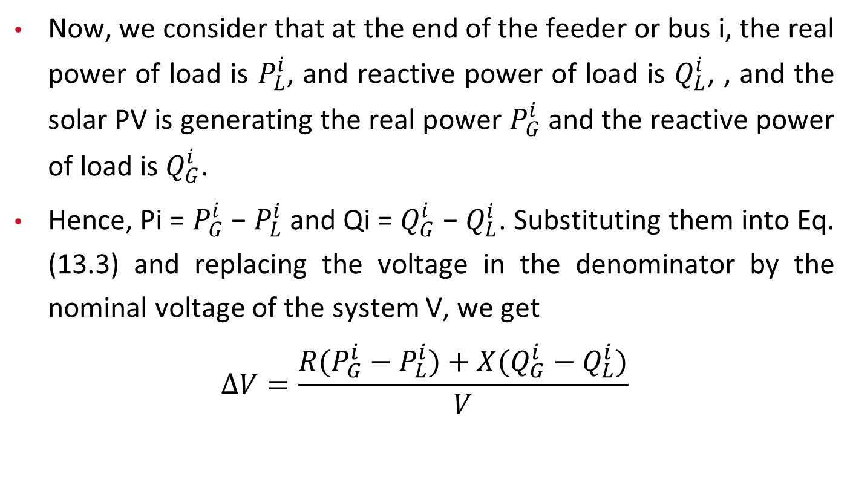
4. Variable Solar Power
Now, we consider that at the end of the feeder or bus i, the real power of load is $P_{L}^{i}$, and reactive power of load is $Q_{L}^{i}$, , and the solar PV is generating the real power $P_{G}^{i}$ and the reactive power of load is $Q_{G}^{i}$.
Hence, Pi = $P_{G}^{i}$ − $P_{L}^{i}$ and Qi = $Q_{G}^{i}$ − $Q_{L}^{i}$. Substituting them into Eq. (13.3) and replacing the voltage in the denominator by the nominal voltage of the system V, we get
$$∆V=\frac{R(P_{G}^{i}−P_{L}^{i})+X(Q_{G}^{i}−Q_{L}^{i})}{V}$$
(13.4)

Slide 41
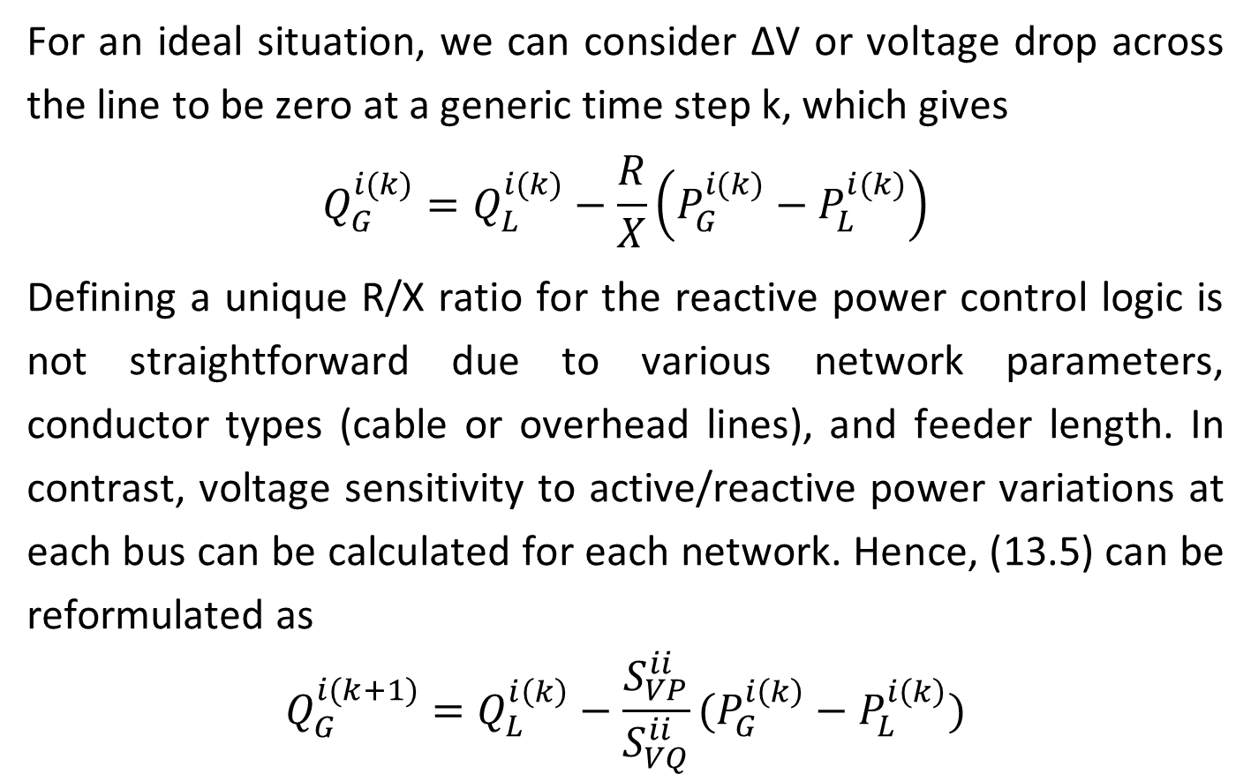
4. Variable Solar Power
For an ideal situation, we can consider ΔV or voltage drop across the line to be zero at a generic time step k, which gives
$$Q_{G}^{i(k)}=Q_{L}^{i(k)}−\frac{R}{X}\left(P_{G}^{i(k)}−P_{L}^{i(k)}\right)$$
Defining a unique R/X ratio for the reactive power control logic is not straightforward due to various network parameters, conductor types (cable or overhead lines), and feeder length. In contrast, voltage sensitivity to active/reactive power variations at each bus can be calculated for each network. Hence, (13.5) can be reformulated as
$$Q_{G}^{i(k+1)}=Q_{L}^{i\left(k\right)}−\frac{S_{VP}^{ii}}{S_{VQ}^{ii}}(P_{G}^{i\left(k\right)}−P_{L}^{i\left(k\right)})$$
(13.5)
(13.6)

Slide 42
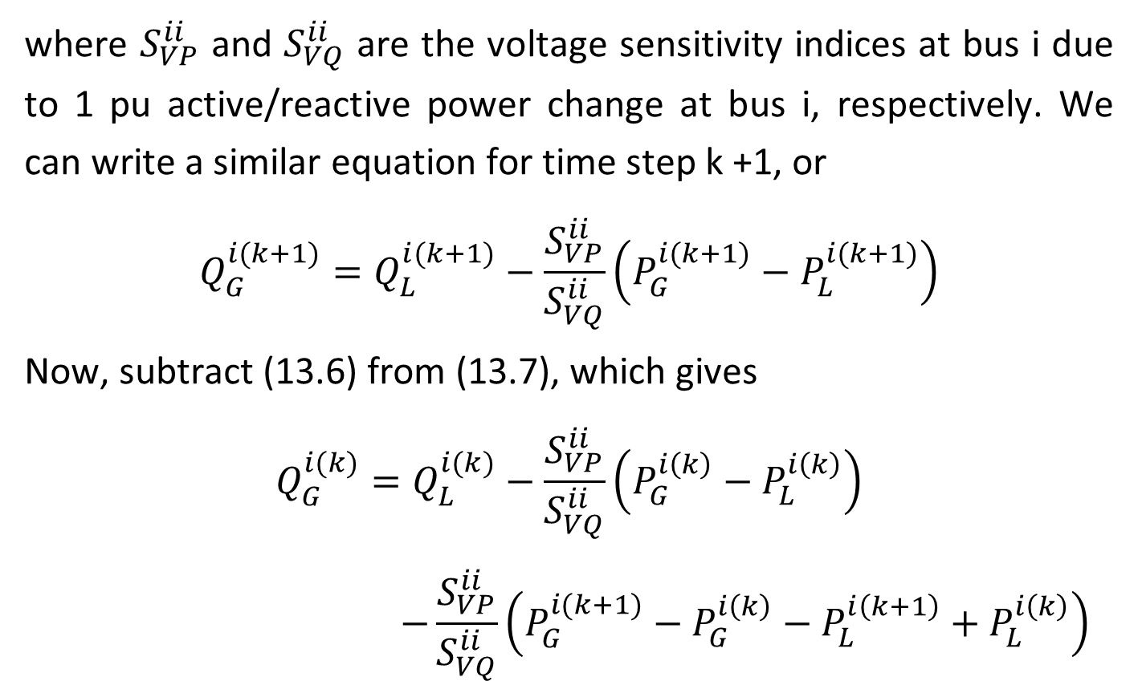
4. Variable Solar Power
where $S_{VP}^{ii}$ and $S_{VQ}^{ii}$ are the voltage sensitivity indices at bus i due to 1 pu active/reactive power change at bus i, respectively. We can write a similar equation for time step k +1, or
$$Q_{G}^{i(k+1)}=Q_{L}^{i(k+1)}−\frac{S_{VP}^{ii}}{S_{VQ}^{ii}}\left(P_{G}^{i(k+1)}−P_{L}^{i(k+1)}\right)$$
Now, subtract (13.6) from (13.7), which gives
$$Q_{G}^{i(k)}=Q_{L}^{i(k)}−\frac{S_{VP}^{ii}}{S_{VQ}^{ii}}\left(P_{G}^{i\left(k\right)}−P_{L}^{i\left(k\right)}\right)$$
$$−\frac{S_{VP}^{ii}}{S_{VQ}^{ii}}\left(P_{G}^{i(k+1)}−P_{G}^{i\left(k\right)}−P_{L}^{i\left(k+1\right)}+P_{L}^{i\left(k\right)}\right)$$
(13.7)
(13.8)

Slide 43
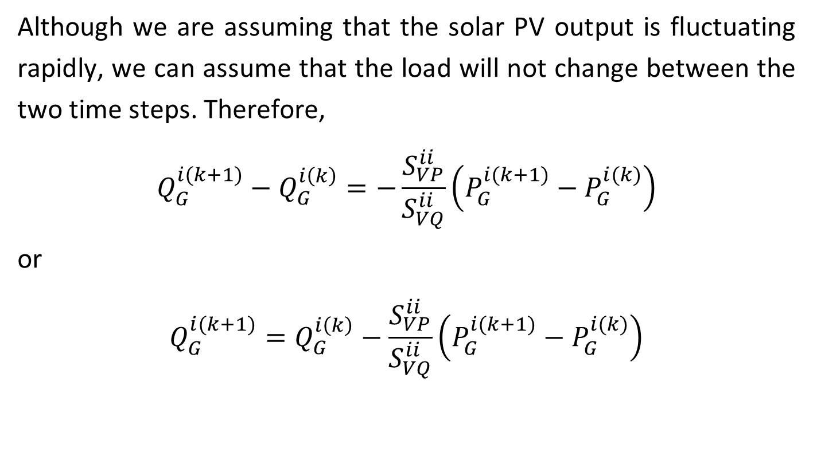
4. Variable Solar Power
Although we are assuming that the solar PV output is fluctuating rapidly, we can assume that the load will not change between the two time steps. Therefore,
$$Q_{G}^{i(k+1)}−Q_{G}^{i\left(k\right)}=−\frac{S_{VP}^{ii}}{S_{VQ}^{ii}}\left(P_{G}^{i(k+1)}−P_{G}^{i(k)}\right)$$
or
$$Q_{G}^{i(k+1)}=Q_{G}^{i\left(k\right)}−\frac{S_{VP}^{ii}}{S_{VQ}^{ii}}\left(P_{G}^{i(k+1)}−P_{G}^{i(k)}\right)$$
(13.9)
(13.10)

Slide 44
4. Variable Solar Power
Thus, if we can project change in real power generated by solar PV in the next time step, we can proactively adjust the reactive power to mitigate fluctuations in voltage. While implementing the control, we must ensure that the operation is within the limits specified for the inverters.

Slide 45
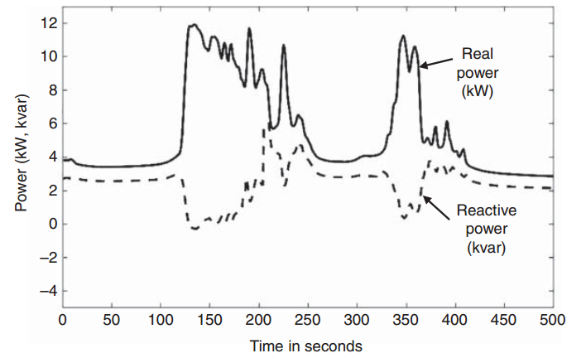
4. Variable Solar Power
Figure 13.4 shows variation in real power (solid line) at a selected bus in the system due to changing solar irradiation. This figure also shows the reactive power (dashed line) injected by the inverter based on Eq. (13.10).
Figure 13.4 Real power variation at a bus due to changing solar irradiation and reactive power injection by inverter to mitigate voltage fluctuations.

Slide 46
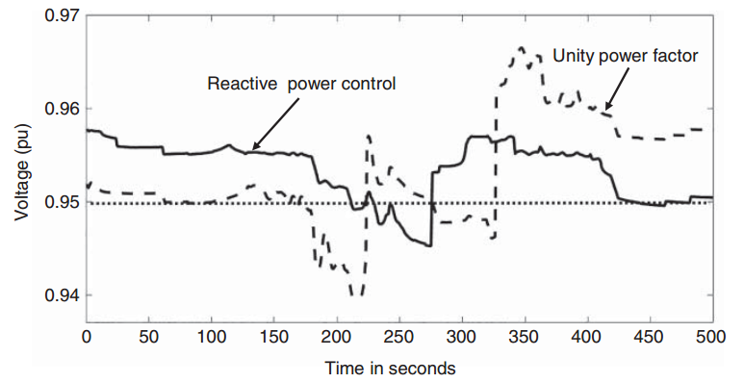
4. Variable Solar Power
Figure 13.5 shows voltage at the same bus with no reactive power or unity power factor (dashed line) and with reactive power control (solid line). The results clearly show mitigation in voltage fluctuations. Also, the voltage drops below the lower limit of 0.95 pu for a shorter duration with control. In addition, the tap operations at the substation transformer have reduced from two to one with control.
Figure 13.5 Voltage at a bus with unity power factor operation and dynamic control with reactive power injection.

Slide 47
5 Microgrids
Over the 150 years of electrification, the power grid has evolved with larger generating resources deployed in centralized locations due to economies of scale. However, due to declining costs, it has become feasible to generate electricity using distributed small-scale generators. In addition to cost, system resiliency due to increased frequency of extreme events causing large-scale disruptions in power supply is becoming a concern.
In the past, facilities that required uninterrupted power supply, such as hospitals, deployed a backup diesel or gas generator, which came into action upon loss of power from the grid.

Slide 48
5 Microgrids
However, now small generators can be operated regularly. They supply power to nearby loads but are ready to take over and operate in an islanded mode whenever the connection to the grid is lost.
This has led to the concept of MG, which is defined as “a group of interconnected loads and DERs with clearly defined electrical boundaries that acts as a single controllable entity with respect to the grid and can connect and disconnect from the grid to enable it to operate in both grid-connected and island modes”.

Slide 49
5 Microgrids
Microgrids can be operated connected to the main network or autonomously. They have been proposed to integrate high penetrations of distributed generation sources that are becoming more commonplace on the distribution system [8, 9]. Microgrids increase system reliability by reducing customer outage and service restoration time.
However, one major issue with implementing MGs is their protection when operating in an islanded mode. This is a result of the fault currents being lower than steady-state currents from voltage-source inverter-connected devices. These devices include battery energy storage systems and PV panels that are often the dominant sources in low- and medium-voltage MGs.

Slide 50
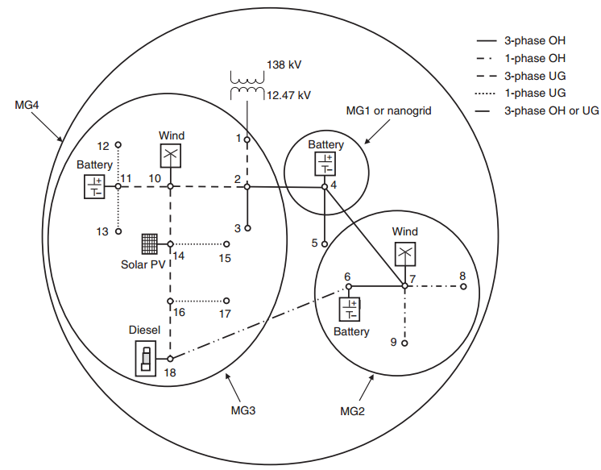
5.1.1 ac Microgrids
The best way to address this issue is to consider the example shown in Figure 13.6, which is an 18-bus radial/looped distribution system. The system has both conventional and renewable generating sources with distinct types.
Figure 13.6 An 18-bus radial/looped example system with four microgrids (MGs). Source: Courtesy of Eaton Corporation.

Slide 51
5.1.1 ac Microgrids
The system also has several single-phase laterals, both overhead and underground. The line connection between buses 6 and 18 is added to close the loop of the otherwise radial system.
Figure 13.6 An 18-bus radial/looped example system with four microgrids (MGs). Source: Courtesy of Eaton Corporation.

Slide 52
5.1.1 ac Microgrids
Since the system has several sources, we can create different boundaries to define the MGs. Typically, an MG with only one DER is not a true MG. Sometimes it is called a nanogrid. One could conceive of selecting different MGs for the same distribution system, but these must be selected a priori so that appropriate real-time actions could be taken when a fault or a disturbance occurs

Slide 53
5.1.1 ac Microgrids
In this figure, four distinct MGs are identified. The three smaller MGs are nested within the entire substation MG. The selection of MGs is based on matching the available local distributed generation with the local loads. Although in this example we have defined the MGs a priori, a flexible approach in which the MG boundaries adapt with changing conditions in the system can be implemented. Such an adaptive system will pose many challenges, which are still under investigation.

Slide 54
5.1.2 dc Microgrids
These are slowly evolving to supply dc loads directly from the dc DERs such as solar and batteries without the need for power convertors to ensure higher efficiency.
The major problem with a dc MG is the lack of commercial fast breakers or switches. Some of them have been developed for low-voltage applications. This is an area that needs additional research in the development of fast and cost-effective solid-state dc breakers at the medium-voltage levels. Another principal issue is the coordination of dc protective devices, a subject that is yet to be investigated.

Slide 55
5.1.3 Hybrid Microgrids
A significant amount of research and development is being carried out in the development of hybrid MGs. From the protection point of view, these are in the infant stage. One could conceive of many topologies which are still being investigated and understood. These MGs involve both ac and dc DER loads, and their protection could become a complex issue which needs further research.

Slide 56
5.1.3 Hybrid Microgrids
In these types of MGs, the role of converters/inverters and their efficient operations including protection need to be well understood. One possible problem is the coordination of a dc breaker with ac protective devices in vogue and future ones to be developed.

Slide 57
5.1.4 Networked Microgrids
Tremendous amount of research efforts is underway in several national labs and other institutions on this subject. However, the concept of networked MGs is based on certain assumptions, which are not practical to implement in real life. As the subject of MGs matures, we will get more clarity on the networking aspect.

Slide 58
5.2 Microgrid Modes of Operation
The modes of operation of MGs are typically divided into three generalized categories: grid connected, islanded, or mixed mode operation. The modes of operation are influenced by a variety of coordinated dispatch functions and control functions that may be scheduled, autonomous, or responsive to local out-of-specification or abnormal conditions either on the interconnected distribution grid or within the MG.

Slide 59
5.2 Microgrid Modes of Operation
The modes of operation are often much different in that the voltage regulation for the loads is based on either very low impedance power source (the utility) or a higher impedance power source (DER related) with resource-limited energy.

Slide 60
5.2.1 Grid-Connected Mode
The grid-connected mode is typically the prevalent operating mode for MGs that are interconnected to the local grid. Energy flow is predominantly from the local grid to local loads within the MG.
Other important flows of energy include charging of batteries, conditioning of thermal storage, providing housekeeping for MG controllers, and communications equipment.
Transitions to and from the grid-connected mode will often utilize communications for dispatch, synchronization, critical protection data, and data-handling requirements.

Slide 61
5.2.2 Islanded Mode
The islanded mode is used for a variety of conditions. Internal supply of power to MG loads during utility outages is used to maintain loads for reliability and resiliency that are typically segregated into critical loads or loads that may be shed according to a schedule of priorities. Other reasons for operating in the islanded mode are becoming increasingly important.

Slide 62
5.2.2 Islanded Mode
A utility may dispatch a MG to curtail the reverse power flow when the distribution system has excess power from the distributed generation such as PVs and wind, and the reverse power may be detrimental to the utility’s operation. Such curtailed generation is likely a situation where advanced information is needed to optimize the operations of the MG and the interconnected utility.
Another important reason for operation in the islanded mode is to better optimize charges that are being implemented as demand charges or even standby charges.

Slide 63
5.2.2 Islanded Mode
The scenarios for transitions to islanded mode include the following:
Planned Islanding The process and steps for a planned islanding event include: (i) receive islanding command either as a scheduled event or as dispatch from the DSO; (ii) balance the load and generation (adjust both P and Q to be 0 at the point of interconnection (POI)); (iii) set local controllers and protection devices appropriately; (iv) create the island; and (v) transition to steady-state islanded dispatch mode.

Slide 64
5.2.2 Islanded Mode
Unplanned Islanding The process and steps for unplanned island events include: (i) detect the need for islanded conditions; (ii) create the island; (iii) set local controllers and protection devices appropriately; (iv) execute the required preplanned actions such as load shedding (and/or implement a black start if required); and (v) transition to steady-state islanded dispatch mode.

Slide 65
5.2.2 Islanded Mode
Reconnection to Grid The process and steps include: (i) resynchronize, set/match voltage, phase angle, and frequency within prescribed limits specified by applicable grid codes or requirements; (ii) set local controllers and protection devices appropriately; (iii) reconnect; and (iv) transition to steady-state connected dispatch mode and restore noncritical loads as appropriate.

Slide 66
5.2.2 Islanded Mode
Transition from Grid to Islanded Operation and Vice Versa The modes and methods for transitions with an electrical grid must be well-coordinated processes that involve communications in the form of dispatch requests. A simple scheduled transition is an option if the protocols for the transitions are predetermined. Transitions typically include a verification of a completed process and reporting on the resulting conditions after the transition is completed. The timing and synchronization are often a range of values. The criteria for transitions are followed by the MG controller.

Slide 67
5.2.2 Islanded Mode
Table 13.1 shows examples of processes, parameters used before the transition, the needed characterizations of the parameters, and applicable protection requirements.
Table 13.1 Typical criteria used for a transition process.
Processes | Parameters | Characterization of parameters | Protection requisites
Transition initiation | Receive transition request or command | Predetermined operational values, limits, and timing needs | Predetermined protection capabilities and limitations
Load/primary source balancing | Assess microgrid loads, microgrid generation, energy storage status, and data collection systems | Adjust loads and generation to values to assure stable operation | V, f, P, Q, settling time, overshoot, time to island, and steady-state values within contractual requirements and equipment limitations

Slide 68
5.2.2 Islanded Mode
Table 13.1 shows examples of processes, parameters used before the transition, the needed characterizations of the parameters, and applicable protection requirements.
Table 13.1 Typical criteria used for a transition process.
Transaction to new operating conditions | Transition timing and speed of transfer | Measure and evaluate transients and any oscillations | Communicate with protection equipment on the utility infrastructure and within the microgrid
New settings | Assess stability, generation, and energy storage values | Measure the new stable values | New V, f, P, Q, settling time, overshoot, time to island, and steady-state values within contractual requirements and equipment limitations
Data acquisition and analysis | Assess dynamic values | Record values before, during, and after transition | Store and analyze new data

Slide 69
5.2.2 Islanded Mode
Metrics are typically specified by the interconnection requirements of the DSO to which the MG is connected, applicable codes and/or standards, or state or local mandates for interconnectivity.
Typical metrics for transitions includes:
Directly measurable quantities: voltage and current (time-domain waveforms).

Slide 70
5.2.2 Islanded Mode
Derived quantities: frequency, root-mean-square (RMS) voltage, RMS current, phase angle, real power (including direction of power flow), reactive power (leading or lagging), energy exchanged at the POI (grid-connected mode), power quality indices (voltage and current harmonic distortion, individual harmonics, voltage sags, and voltage swells), and reference-tracking errors.

Slide 71
5.2.2 Islanded Mode
Scenarios are typically defined for the following basic transitions:
Grid connected to islanded – planned islanding. This transition is initiated upon receipt of an external request, typically sent by the DSO.
Grid connected to islanded – unplanned islanding. This transition is the result of an event on the distribution grid. It can involve a black start if the control system is designed in this manner.
Islanded to grid connection. This transition involves resynchronization and reconnection of the MG.

Slide 72
5.2.2 Islanded Mode
Test scenarios for transitions typically consider the conditions indicated below. They are chosen to allow a complete and comprehensive testing of the transition function, including the required and relevant features of the dispatch function.

Slide 73
5.2.2 Islanded Mode
The initial operating conditions of the MG. These include the operating conditions before the transition occurs: the level of local generation and generation mix (dispatchable and nondispatchable), operation of the storage device (mode of operation and SOC), load composition (constant impedance, constant P-Q, and active loads) and load mix (percentage composition), status of breakers, switches, and voltage control devices, and power (P, Q) exchanges between the MG and the grid (prior to a transition from grid connected to island mode).

Slide 74
5.2.2 Islanded Mode
The state of the grid at the time of the transition. These include the voltage at the POI and any disturbances occurring on the grid at the time of the transition. In the case of an unplanned islanding event, the nature of the event (typically a fault or an open connection on the feeder connected to the POI initiating the islanding transition) is considered.

Slide 75
5.2.2 Islanded Mode
Mixed Mode An MG control system set up in mixed mode still must contain the islanded- and grid-connected functions and supports all forms of planned and unplanned islanding and resynchronization. The difference is that the controls of DERs never change regardless of the grid or the island mode connection. The 2018 NREL MG shootout was won using this technique. Massachusetts Institute of Technology (MIT) MG laboratory is using this technique.

Slide 76
5.3 Grid-Following vs. Grid-Forming Inverters
In the grid-connected mode, the MG gets the reference frequency from the grid, and the resources in the MG operate in synchronism with the grid while controlling the real and reactive power at the DER. In other words, the IBRs operate in the grid-following mode.
However, in the islanded mode, there is no reference signal from the grid, and the resources within the MG must operate in coordination with each other. In the example shown in Figure 13.5, we have included a diesel generator, which could serve as the reference for the MG.

Slide 77
5.3 Grid-Following vs. Grid-Forming Inverters
However, in the future with waning of diesel generators, we can expect only renewable generation and BESS or IBRs to be deployed in the MGs. In such cases, the MG will have only low-inertia IBRs, which makes operation of the MG in islanded mode challenging.
To facilitate operation under such conditions, the concept of grid-forming inverters has come into vogue. The grid-forming inverters have the capability to control frequency and terminal voltage. They also work cooperatively to share the load in the MG in preassigned portion based on the size of the DER they are controlling.

Slide 78
5.3 Grid-Following vs. Grid-Forming Inverters
Thus, an MG could have a mix of grid-forming and -following inverters. The challenge, however, is that the inverters operating as grid forming in the islanded mode will have to revert to grid following whenever the connection to the grid is made. This subject has only recently started getting attention in the research community.
Federal agencies, such as Department of Energy, are investing substantial sums of money on this research, and we are expecting significant developments on this subject in the future.

Slide 79
5.4 Microgrid Protection Challenges and Requirements
As innovative technologies and DER resources including renewables penetrate the system, making it complex, it is imperative that the critical issue of protection be identified and ways are paved to achieve efficient and effective means of realizing them. The protection of even a classical, passive, and radial distribution system has always been very challenging. The practices vary widely even within a utility, let alone among utilities.

Slide 80
5.4 Microgrid Protection Challenges and Requirements
Protection challenges in the distribution systems abound now with the challenges of DERs including inverter-based generation and storage and new configurations for aggregation and MGs [13–20]. The microprocessor relay of today is a mature and reliable technology. However, its technology must be adapted to the needs of the distribution networks as they have evolved with high penetrations. The starting point for this adaptation is MGs with unique protection requirements.

Slide 81
5.4 Microgrid Protection Challenges and Requirements
Protection requirements for MG systems are unique and different from general protection issues, known and applicable to distribution systems, because of the large amount of DERs present and of the MG control systems overseeing the overall operation. Further, the design of protection systems for a MG in the islanded mode is different from that in the grid-connected mode because of the absence of strong voltage sources.

Slide 82
5.4 Microgrid Protection Challenges and Requirements
Multifunctional microprocessor relays as intelligent electronic devices (IEDs) are the primary MG control, protection, metering, and monitoring devices for some of the most successful MGs and as such deserve a closer inspection as a solution to these problems. An overview of the protection systems today and the advancements required to meet the challenges for protection in the distribution system, starting with MGs, are discussed in detail in a report.

Slide 83
5.4 Microgrid Protection Challenges and Requirements
The focus on the modes of operation and transitions is paramount. It is essential to protect an MG for all modes of operation including transitions against all types of faults, and this is a real challenge. The philosophy for MG protection is to have the same protection architecture for both islanded and grid-connected operations. A fast-acting smart switch such as a solid-state circuit breaker is to be developed to open for all faults that could occur in a MG.

Slide 84
5.5 Examples of Microgrid in Operation
While the concept of MGs has matured, the technology to support these concepts is still evolving. The idea of operating an existing distribution system as a MG will take several years to mature because the utilities or DSOs do not have much financial incentive to do so. Typically, DERs are owned and installed by customers to increase their own resiliency. The DSOs will have to invest significant sums of money on monitoring and control equipment to operate the system as a MG.

Slide 85
5.5 Examples of Microgrid in Operation
While large utilities will not find it advantageous to do so, small municipal DSOs or rural electric cooperatives (RECs) may find it advantageous to do in certain situations. Typically, municipal DSOs and RECs do not have their own generation. They buy electricity from wholesalers and distribute it to their customers. Some such organizations are already contemplating installation of their own solar PV generation and BESS. It could become feasible for them to invest in the MG technology.

Slide 86
5.5 Examples of Microgrid in Operation
The most valuable implementation of MG technology is for institutions or large businesses who have their own campus of large facility. There are several examples of such MGs. Another area where MGs play a crucial role is electrification of remote rural communities. In this section, we look at some MGs that are successfully operating.

Slide 87
5.5.1 CERTS Microgrid
The Consortium for Electric Reliability Technology Solutions (CERTS) in the U.S., which includes several national laboratories and universities, introduced their concept of the MG in a white paper to effectively integrate DERs. The CERTS Microgrid Concept provides a novel approach for operation and control of DERs and loads within a MG with minimal communication requirement for safe and stable operation.

Slide 88
5.5.1 CERTS Microgrid
The CERTS Microgrid Concept especially focuses on automatic and seamless transitions between grid-connected and islanded modes of operation, equipment protection within the MG with low fault currents, and MG control for voltage and frequency stability under islanded conditions without depending on high-speed communications.

Slide 89
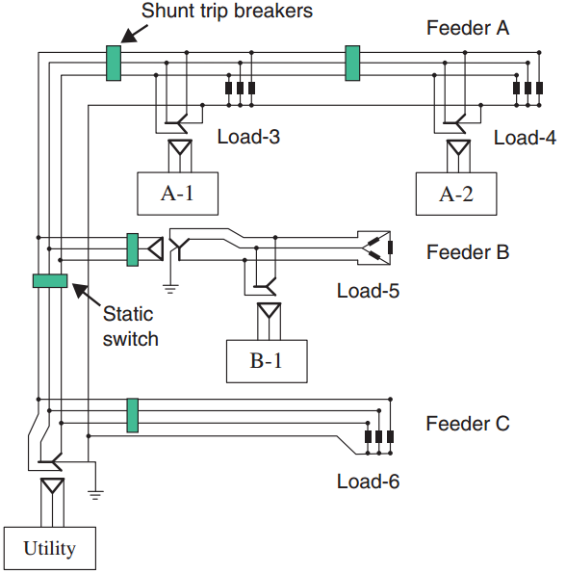
5.5.1 CERTS Microgrid
To demonstrate the concepts, CERTS developed a test bed near Columbus, OH, in collaboration with American Electric Power (AEP). Phase 1 of the test bed shown in Figure 13.7 has three feeders (A, B, and C) with loads and three DERs.
Figure 13.7 CERTS microgrid test bed. Source: Adapted from Lasseter et al.

Slide 90
5.5.1 CERTS Microgrid
One feeder has two DERs (A-1 and A-2), another feeder has one DER (B-1), and the third feeder only has load. The static switch isolates feeders A and B from the grid to allow the MG to operate in the islanded mode.
Figure 13.7 CERTS microgrid test bed. Source: Adapted from Lasseter et al.

Slide 91
5.5.1 CERTS Microgrid
The four load banks (Load-3 to Load-6) have capabilities of remote control with loads ranging from 0 to 90 kW and 0–45 kvar. Each load bank also has capabilities to simulate faults ranging from bolted faults to high impedance faults. Other equipment include a variable power induction motor (0–20 HP), protection relays, shunt trip breakers, and a digital data acquisition system to capture voltage and current waveforms at different locations.
In the later phases of the project, a conventional synchronous generator and a stand-alone electricity storage device were added to the test bed.

Slide 92
5.5.2 IIT Microgrid
Following the 12 major power outages, Illinois Institute of Technology (IIT) decided to join the Galvin Electricity Initiative (GEI) for perfect power [23]. While the campus already had two 4-MW combined cycle gas units and a small wind turbine, rooftop PV and a 500-kWh battery were added to boost the generation capacity to meet the needs of the IIT campus with a peak load of around 10 MW. Several system upgrades were implemented, and control equipment have been deployed to operate the system as an MG. The MG can operate both in the grid-connected and islanded modes.

Slide 93
5.5.2 IIT Microgrid
The overall goal of the perfect power MG is to provide real-time reconfiguration of power supply assets, real-time islanding of critical loads, and real-time optimization of power supply resources. In addition to providing reliable power supply to the campus, the MG is also a test bed for testing emerging smart grid technologies.

Slide 94
5.5.3 Philadelphia Navy Yard Microgrid
The Philadelphia Navy Yard was abandoned about 25 years ago but now is a vibrant commercial center managed by Philadelphia Industrial Development Corporation (PIDC). A unique feature of the redeveloped Navy Yard is that it is powered by an MG. About 170 employers occupy 7.5 million square feet of space, and 15,000 individuals work there. A motivation to deploy the MG was to provide premium power to the customers while leveraging natural gas and local renewables to enhance the Navy Yard and community grid independence and energy security.

Slide 95
5.5.3 Philadelphia Navy Yard Microgrid
In addition, the MG will enhance the reliability, efficiency, capacity, and resilience of the PECO’s local distribution grid. The facility is also a test bed for evolving MG technologies. The MG includes an 8-MW natural gas generator, a 600-kW fuel cell plant, 1-MW solar PV, and a 6.2-MW/14.8 MWh Li-ion BESS.

Slide 96
6 Off-Grid Electrification
Electrical energy needs are growing globally due to increased dependence on electricity for daily activities in homes and businesses. While much of the world enjoys electricity for conveniences and necessities of daily life, about one billion people have no access to electricity. The absence of electricity creates barriers for family life as well as educational and economic opportunities. Also, people without access to electricity depend on wood for cooking and kerosene for lighting. Emissions from burning these fuels are harmful to people’s health and contribute significantly to greenhouse gases.

Slide 97
6 Off-Grid Electrification
The extremely prohibitive cost of grid expansion and a lack of available fuel resources to generate electricity have been hurdles for electrification of regions such as sub-Sahara Africa. Extending the grid to meet electricity needs of a small population, especially in rural areas with low population density, is not always viable. Instead, localized electricity generation in stand-alone or MG applications is a suitable option.

Slide 98
6 Off-Grid Electrification
Small-scale wind and solar power generation are attractive for such applications. A solar panel with a battery can meet the lighting needs of a small house, while a small wind machine can power a few homes. The most technically and economically promising solution for such situations is a combination of different resources for electricity production. The systems for each location must be appropriate for the local economic and social conditions.

Slide 99
6.1.1 Load Estimation
The first step is determination of load demand for the community. This starts by counting the number of households, schools, shops, and other entities in the community. The next step is the estimation of loads in each energy-consuming unit and the usage pattern. This can be done by conducting a survey of the communities or by considering a fixed load for each household, such as one or two lights. The usage pattern will require information on weather conditions and lifestyle of the local population. Based on this information, daily hourly aggregate load profile for different seasons can be developed.

Slide 100
6.1.2 Resource Assessment
This step requires an evaluation of available resources in the area, such as wind, solar, microhydro, and conventional resources. Wind and solar resource assessment will require yearly wind and solar irradiation data. National Renewable Energy Laboratory (NREL) in the U.S. maintains such data for many parts of the world. Microhydro availability will depend on the local conditions, such as a mountain stream or a nearby river as well as water flow pattern for the year. Conventional resource availability will depend on the local market conditions for specific equipment and fuel.

Slide 101
6.1.3 Optimal System Design
The optimal design for the given locality requires cost data for different feasible resources. The data include capital as well as operation and maintenance cost. For conventional resource, the cost of fuel and penalties for emissions, if any, are needed. The cost would also include any specialized equipment such as batteries and other control equipment, such as inverters, meters, and communication layer. We can use these data along with load and resource information to determine an optimal design for a given life span of the MG.

Slide 102
6.1.4 Other Factors
The basic design assumes that all the households receive electricity whenever they need without any curtailment. However, if they are willing to accept curtailments, the cost of generating electricity can be reduced significantly because that allows reduction in the size of batteries and other generating resources needed in the system.

Slide 103
Thank You!

